Slide 1
Wolf Creek Elementary School PTA
General Body
PTA Meeting
May 16, 2023

Slide 2
Agenda
Call to Order & Welcome
President’s Report
Principal’s Update
Unfinished Business
New Business
Treasurer’s Report
Announcements
Adjournment

Slide 3
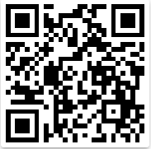
Attendee Sign-in Sheet
https://tinyurl.com/wcesptasignin

Slide 4
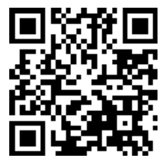
President’s Report
Join Online
Compliance Update
501(c)3 Status Has Been Restored (not yet back-dated)
2017-2021 tax submissions can be submitted once tax-exempt status is restored for those years (not a guarantee), or
We will have to pay the taxes due on each of the outstanding tax years (2017-2022)
2022-2023 school will be tax-exempt, but Form 990 must be submitted by fall 2023 deadline
2023 Updated ByLaws
Available on WolfCreekPTA.org website
Changes: April elections, $28 Dues
2023-2024 PTA Executive Board Nominations Underway!
Meeting Attendee Sign-in Sheet:

Slide 5
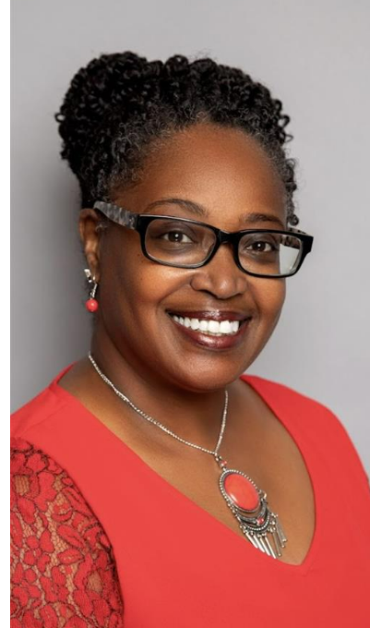
Principal’s Updates
Join Online
Principal: Dionne C. Glass
Meeting Attendee Sign-in Sheet:

Slide 6
Unfinished Business
Join Online
2021-2022 Campus Beautification Project
Wall wraps: Cafeteria, Foyer, Windows, Bus Area Posts
Installation Complete
Incomplete Setup of Basketball Goals Received Last Year
Setup Complete
Boosterthon T-shirt Payment
$4,423.50 Due Now
Meeting Attendee Sign-in Sheet:

Slide 7
New Business
Nomination Form: https://tinyurl.com/wcesptanominations
Nominations for PTA Executive Board:
2023-2024 School Year
President
Vice President
Secretary
Treasurer
Join Our PTA
Please note that you must be a current, dues-paying PTA member for the 2022-2023 school year to be eligible to serve on the 2023-2024 PTA Executive Board. You can pay your dues now by accessing the “Join Our PTA” QR code to the left.
Meeting Attendee Sign-in Sheet:

Slide 8
New Business – Current Nominations
President | Vice President | Secretary | Treasurer | Parliamentarian
Lee Adams | Brian Christian | Kendra Smith | Eleanor West | Cathy Lewis
Yolanda Charles | Dr. Toniya Farmer | Keisha Lash-Edwards | Amanda Baker | Breone Thomas
Join Our PTA
Bolded names came in from online nomination form.
Please note that you must be a current, dues-paying PTA member for the 2022-2023 school year to be eligible to serve on the 2023-2024 PTA Executive Board. You can pay your dues now by accessing the “Join Our PTA” QR code to the left.
Meeting Attendee Sign-in Sheet:

Slide 9
Treasurer’s Report
Join Online
2022 - 2023 SY
Budget + Actuals
(as of April Bank Statement)
Presented by: Janay Pulliam, Treasurer
Meeting Attendee Sign-in Sheet:

Slide 10
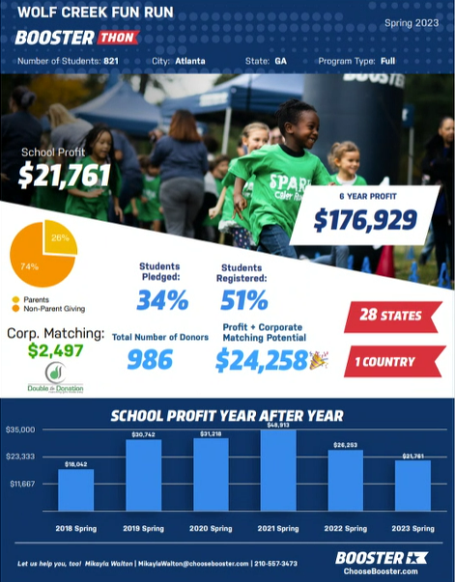
Announcements: Year-End Provisions
Boosterthon Goal: $20,000
Boosterthon Funds Raised: $24,258
Teacher & Staff Appreciation Week:
Breakfast for all staff (Gocha)
$25 Teacher Gift Cards to Amazon
$15 Staff Gift Cards to Amazon
Classroom Grants:
$50 Teacher Gift Cards to Lakeshore Learning
Join Online
Meeting Attendee Sign-in Sheet:

