Slide 1
Wolf Creek Elementary School PTA
General Body
PTA Meeting
December 8, 2022

Slide 2
Agenda
Call to Order & Welcome
President’s Report
Principal’s Update
Treasurer’s Report
Unfinished Business
New Business
Announcements
Upcoming Events
Adjournment

Slide 3
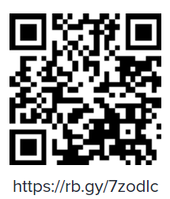
Attendee Sign-in Sheet
https://rb.gy/7zodlc

Slide 4
Welcome to Our 22 New PTA Members!
Venika Bazemore
Novella Bridges
MiKayla Carney
Mark Chambers Jr
Domonique Cunningham
Brook Everett
Brian Farmer
Dr. Toniya Farmer
Nikole Green
Tamela Harris
Evie Howard
Raye Lilley-Chambers
Roxanne Maiga
Shenelle Moolenaar
Autrellia Parks
Lisa Parnell-Cunningham
Brandon Reynolds
Nicky Scott
Samira Smith
Shannon Stephens
Wenonah Wells
Alison Wordlaw
Join Online
Meeting Attendee Sign-in Sheet:

Slide 5
President’s Report
Join Online
Together
Our PTA partners closely with local businesses and community leaders to support our school.
PTA receives givebacks based on local sales from Kroger, Publix, and Office Depot
As a 501c3, PTA is eligible for matching donations from many large corporations
PTA helps keep parents, teachers, and the community connected on local governmental policy changes that affect our kids
Everyone
We want every family in our school to join our PTA because we can do more together than apart! Not just parents and teachers, all family members, friends, and community members are encouraged to participate!
Share Ideas
Raise Concerns
Help Plan our Budget
Volunteer at Events
Buy PTA Swag
Achieves
More than 85 research studies conducted over the past 30 years prove that kids do better when parents are involved:
Grades are higher
Test scores improve
Attendance increases
Since the establishment of our PTA, Wolf Creek’s GA DOE CCRPI score (measuring content mastery, progress, closing gaps, and readiness) has increased from 61 in 2017 to 79.5 in 2019.
More
Our PTA raises over $50,000 annually through Boosterthon and other fundraisers to support school initiatives and fun events:
School Beautification
WCES Bouncey House, Rock Wall, & Basketball Goals
Reading Carnival (Books)
Trunk or Treat (Candy & Décor)
Christmas Gift Bags
Teacher Appreciation Breakfasts, Lunches, & Gift Bags
How does our PTA help our school?
Meeting
Attendee
Sign-in Sheet:

Slide 6
President’s Report
Join Online
Compliance Update
2021-2022 SY Audit Completed by 9/30 Deadline
501(c)3 Status Has Been Restored (not back-dated)
2017-2021 tax submissions can be submitted once tax-exempt status is restored for those years (not a guarantee), or
We can pay the taxes due on each of the outstanding tax years ()
Taxes for 2022-2023 school year not due until late next year
Redistricting Committee
Chair – Tanya Anderson Woodward
6 Members
Meeting Attendee Sign-in Sheet:

Slide 7
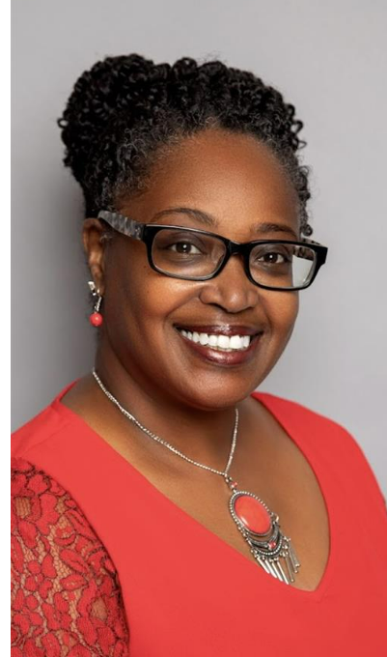
Principal’s Updates
Join Online
Principal: Dionne C. Glass
Meeting Attendee Sign-in Sheet:

Slide 8
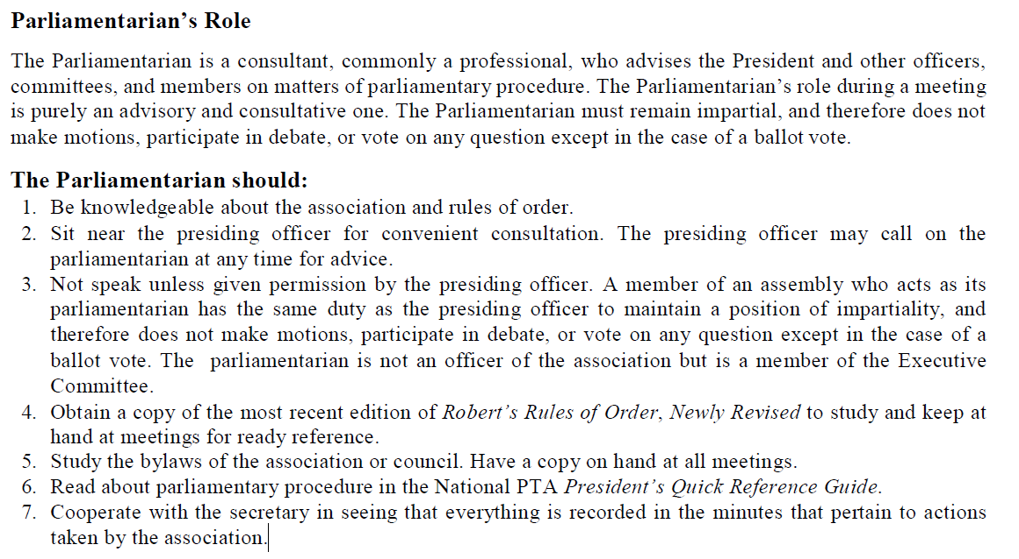
Parliamentarian Position is Still Open!
Interested?
Send an email to president@wolfcreekpta.org to nominate an outstanding parliamentarian!
Meeting Attendee Sign-in Sheet:

Slide 9
Treasurer’s Report
Join Online
Remaining Balance
(2021-2022 SY)

Slide 10
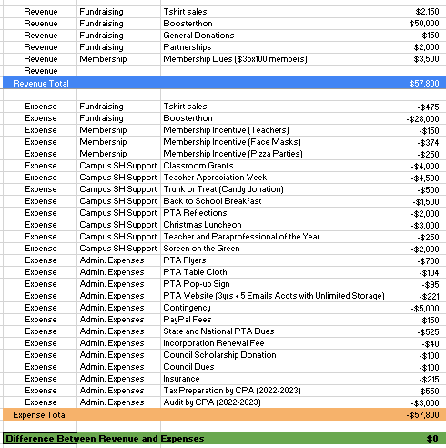
Treasurer’s Report
Join Online
Proposed Budget
(2022-2023 SY)

Slide 11
Unfinished Business
Join Online
2021-2022 Campus Beautification Project
Wall wraps: Cafeteria, Foyer, Windows, Bus Area Posts
Installation To Be Scheduled After Holidays
Incomplete Setup of Basketball Goals Received Last Year
Any parents available to help with below?
Ordering missing parts and/or
Completing setup
Meeting Attendee Sign-in Sheet:

Slide 12
New Business
Sign up online: https://forms.office.com/r/nD7AnPbBDq
Join A Committee:
Membership
Family Engagement
Social Media
Event Planning
Redistricting
Join Our PTA
After sign-up, you should receive an email from our vice president, Yolanda Charles vicepresident@wolfcreekpta.org on next steps to get involved.
Meeting Attendee Sign-in Sheet:

Slide 13
New Business
Redistricting Committee Update:
Round 1 Meeting: Thurs 9/15 – Community Input Ahead of Map Proposal
Round 2 Meeting: Thurs 10/6 – Community Input on Proposed Maps
Round 3 Meeting: Thurs 10/20 – Community Input on Revised Maps
Presentation of Maps to Board – Tues 11/8
Board Votes on Final Maps – Thurs 12/15
Join the Committee:
Send an email to WCESredistricting@gmail.com with the following information:
Join Our PTA
Name
Grade Level of Child(ren)
Phone Number
Email Address
Subdivision or Residential Area
Meeting Attendee Sign-in Sheet:

Slide 14
New Business
Join Online
Motion to Update By-Laws:
Annual Dues Update: $35 with 20% Discount Through 10/15.
Date Updates
Article VI, Section 3: Officer Election in April
Article VI, Section 8c: Nominating Committee Selections Reported during General Body Meeting in April
Article XIII, Section 3: Election meeting date should match Article VI, Section 3 (April)
Meeting Attendee Sign-in Sheet:

Slide 15
Announcements
Join Online
PTA Shirt Sales: $20 (only 16 shirts) for a total of $1,380 Total Shirt Sales
Trunk or Treat:
PTA donated $500 worth of candy and passed out candy and flyers
Membership Drive Results
Pizza Party for Class with Highest Membership
42% of 250 Goal
106 Members
20 Pre-K
3 Kindergarten
32 1st Grade
16 2nd Grade
19 3rd Grade
21 4th Grade
11 5th Grade
Meeting Attendee Sign-in Sheet:

Slide 16
Upcoming Events
Join Online
Date TBD – PTA Holiday Luncheon - 2 Catering Options:
Gocha ($1,824) – 120 Servings
Flying Biscuit ($2,205) – 100 Servings
Mon 12/12 – Warren Community Mtg @ Wolf Creek (6 PM)
Parents encouraged to attend
Wed 12/14 – Holiday Program 6:00 PM
Please contact Ms. Samuels to volunteer.
Wed 12/14 – Thurs 12/15 – Holiday Celebrations with students (12:30-1:30 PM)
Please contact your child’s teacher to volunteer.
Fri 12/16 – Math Extravaganza (All day)
Please contact Mrs. Haywood to volunteer.
12/19 - 12/23 Winter Holidays – Schools Closed
Meeting Attendee Sign-in Sheet:

