Slide 1
Wolf Creek Elementary School PTA
General Body
PTA Meeting
September 13, 2022

Slide 2
Agenda
Call to Order & Welcome
President’s Report
Treasurer’s Report
Unfinished Business
New Business
Announcements
Adjournment

Slide 3
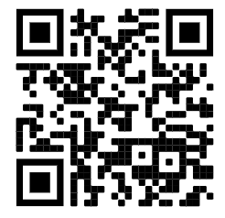
Attendee Sign-in Sheet
https://forms.gle/EFfct1uLJPp5Mr8E6

Slide 4
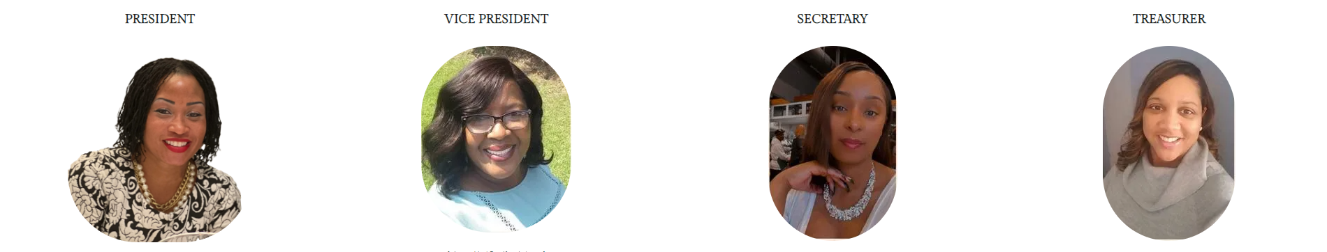
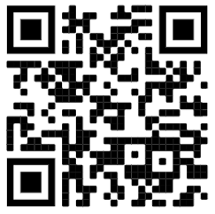
Congratulations to our New Board Members!
[president@wolfcreekpta.org]
Dr. Dionne Roberts
Parent - 5th Grade
Analytics Manager
(Coca-Cola)
[vicepresident@wolfcreekpta.org]
Yolanda Charles
Teacher – 3rd Grade
(Wolf Creek Elementary)
[secretary@wolfcreekpta.org]
Dominique Brown-Nelson
Parent - 2nd Grade
Program Coordinator
(Public Health)
[treasurer@wolfcreekpta.org]
Ms. Janay Pulliam
Parent - 4th Grade
Assistant Principal
(Skyview High)
Meeting Attendee Sign-in Sheet:

Slide 5
Welcome to Our 81 PTA Members for the New School Year!
Shaloa Barnes
Sharon Bates
Sharon Benjamin
Kayla Bennings
Tiffany Berry
Kalia Bonner
Shaunte Braggs
Pauline Brown
Summer Brown
Psylane Brown
Dominque Brownnelson
Deidre Caldwell
Mosa Charles
Yolanda Charles
Ambria Clark
Haisahn Clark
Bernard Coxton Jr.
Natasha Crumbles-Mitchell
Melissa Darden
Patti Davis-Smith
Shanna Dozier
Raven Durant
Stacey Dutton
Jenna Edwards
Summer Esquerre
Fatima Felton
Melanie Fields
Shaikara Flowers
Dionne Glass
Justin Goodwin
Natrina Goodwin
Savita Guthrie
Michelle Hall
Chandra Haslem
Todd Haslem
Cynthia Holmes
Margaret Hottle
Alicia Hoyte
Zeleria Johnson
Ashley Jones Hodo
Nettkiya Joseph
Melanie Lawson
Jeanette Lee
Patrice Lister
Jose Lopez
Sabrina Lord
Brittani Lyles
Alan Maffett
Victoria Mansour
Rachel Maye
Kelli Mcclendon
Richard McQueen
Cilia Miles
Sindy Miranda
Coquesa Moore
LaToya Moore
Laporshia Mount
Aalyih Muhammad
Tiffanie Nelson
Carmen Newman
Jacoby Pegues
Carla Pettis
Janay Pulliam
Kudrat Raji
Luvenia Ramsey
Veronica Ransom
Laronda Ratliff
LaCrecia Reynolds
Jamal Richardson
Michelle Richardson
Dionne Roberts
Keisha Sawyer
Shari stokes
Eugene Strawn
Danielle Walker
Stacey Watson
Eleanor West
Chastity Williams Rhodes
Charisse Wilson
Taneshia Wilson
Latanya Woodward

Slide 6
President’s Report
Join Online
Together
Our PTA partners closely with local businesses and community leaders to support our school. We receive:
Givebacks based on local sales from Kroger, Publix, and Office Depot
As a 501c3, we are eligible for matching donations from many large corporations
Parents, teachers, and community members help to support & staff our programs
Everyone
We want every family in our school to join our PTA because we can do more together than apart! Not just parents and teachers, all family members, friends, and community members are encouraged to participate!
Share Ideas
Raise Concerns
Help Plan our Budget
Volunteer at Events
Buy PTA Swag
Achieves
More than 85 research studies conducted over the past 30 years prove that kids do better when parents are involved:
Grades are higher
Test scores improve
Attendance increases
Since the establishment of our PTA, Wolf Creek’s GA DOE CCRPI score (measuring content mastery, progress, closing gaps, and readiness) has increased from 61 in 2017 to 79.5 in 2019.
More
Our PTA raises over $50,000 annually through Boosterthon and other fundraisers to support school initiatives and fun events:
WCES Bouncey House & Rock Wall
WCES Basketball Goals
Reading Carnival (Books)
Trunk or Treat (Candy & Décor)
Christmas Gift Bags
Teacher Appreciation Breakfasts, Lunches, & Gift Bags
How does our PTA help our school?
Meeting Attendee Sign-in Sheet:

Slide 7
President’s Report
Join Online
Compliance Update
2017-2020 Tax Submissions Rejected by IRS
2021-2022 SY Audit Due 9/30
CPA has been hired to complete both
Parliamentarian Position is Open
Ensures all policies and procedures are followed
Appointed by PTA President
Interested? Send an email to ourboard@wolfcreekpta.org
Meeting Attendee Sign-in Sheet:

Slide 8
Treasurer’s Report
Join Online
Remaining Balance
(2021-2022 SY)

Slide 9
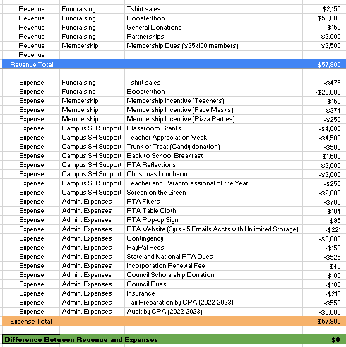
Treasurer’s Report
Join Online
Proposed Budget
(2022-2023 SY)

Slide 10
Unfinished Business
Join Online
2021-2022 Campus Beautification Project
Wall wraps: Cafeteria, Foyer, Windows, Bus Area Posts
Proposals Received, Awaiting Designs
Incomplete Setup of Basketball Goals Received Last Year
Any parents available to help with below?
Ordering missing parts and/or
Completing setup
Meeting Attendee Sign-in Sheet:

Slide 11
New Business
Sign up online: https://forms.office.com/r/nD7AnPbBDq
Join a Committee!
Membership
Family Engagement
Social Media
Event Planning
Redistricting
Help Prepare for and/or Serve as PTA Rep at Events!
RMS Curriculum Night -- Thursday 9/15
Curriculum Night -- Tuesday 9/20
Trunk or Treat -- Friday 10/28
Christmas Gift Bags -- TBD (December)
Boosterthon -- 4/18 – 4/26
Reading Carnival -- Friday 4/23
Teacher Appreciation Week -- 5/1 – 5/5
Join Our PTA
Meeting Attendee Sign-in Sheet:

Slide 12
New Business
Join Online
30 Day Notice of Proposed Changes to By-Laws:
Annual Dues Update
Date Updates
Article VI, Section 3: Officer Election in April
Article VI, Section 8c: Nominating Committee Selections Reported during General Body Meeting in April
Article XIII, Section 3: Election meeting date should match Article VI, Section 3 (April)
Meeting Attendee Sign-in Sheet:

Slide 13
Announcements
Join Online
T-shirt Sales: $1,367 Raised for Wolf Creek Elementary!
Next T-Shirt Fundraiser Starts Today!
Check Class Dojo or wolfcreekpta.org for details
https://tinyurl.com/wolfcreekptashirts
Curriculum Night: Tuesday, 9/20
Membership Drive Ongoing
20% Discount on Annual Dues Until 10/15
Pizza Party for Class with Highest Membership
Order Here

